Slide 1
C3879C Capstone Project
Project Final Report
Safety Helmet detection
Lim Zhao Hong
20065320

Slide 2
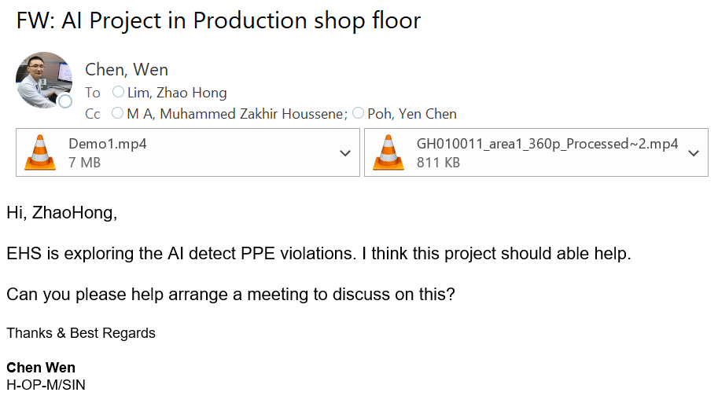
Problem Statement
Due to internal request, there is a change in project scope

Slide 3
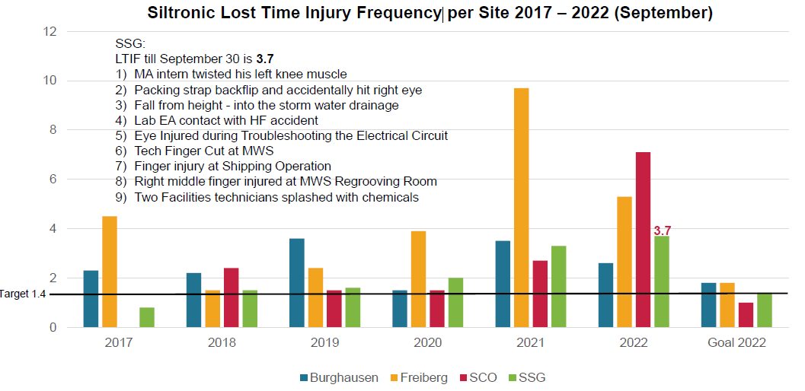
Problem Statement
Recent LTIF (Lost Time Injury Frequency) trends and accident have been escalating, which has to be improved.
site A
site B
site C
site D

Slide 4
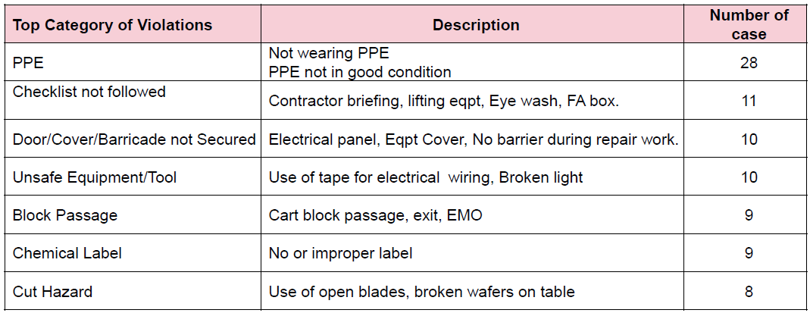
Problem Statement
Therefore it is important to avoid and prevent repetition of these or similar accidents in future.
Among the top reason that result in accident is due to Inadequate PPE protection or failing to wear PPE.

Slide 5
Project Specification
The Objective of this project to harness computer vision to detect PPE violations to raise awareness and avoid/prevent repetition of these or similar accidents in future
For a start, the project would take a series of images with people wearing and not wearing safety helmets (PPE) for training and validation purpose.
Transfer learning of the pre-trained model would be applied onto CCTV monitoring where safety helmet is required in those area
Notes:
Apply Real Time Streaming Protocol (RSTP) for IP camera

Slide 6
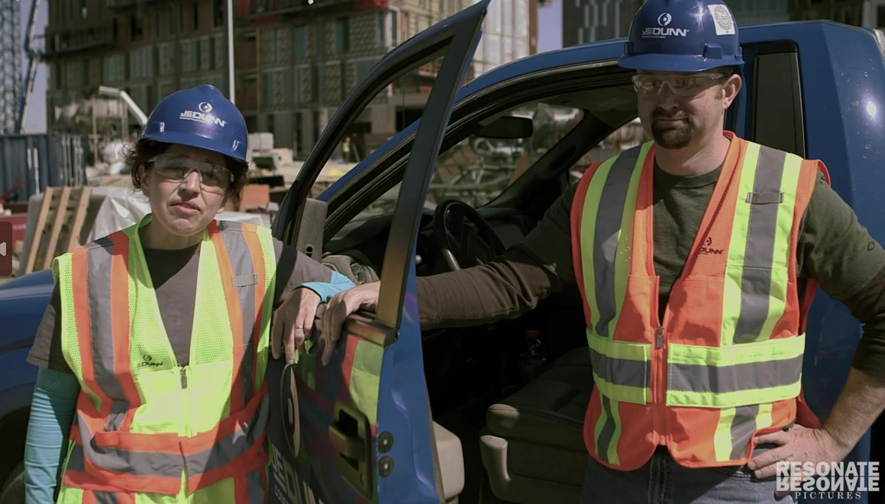
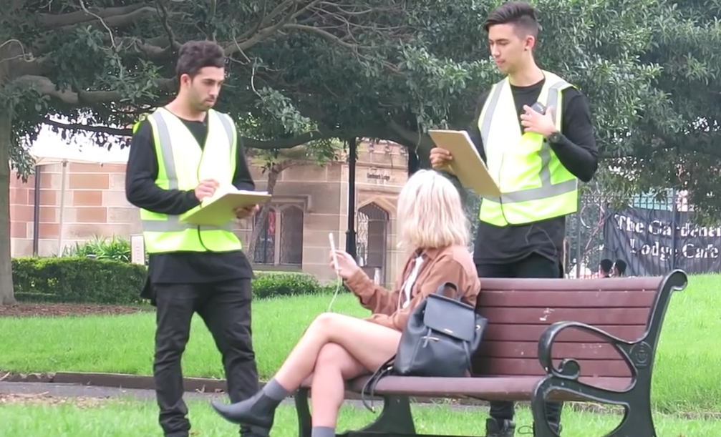
Project Methodology / Approach
Knowledge of Python, Deep learning concepts, and Computer Vision is required to process data and get an optimized pre-trained network
With the pre-trained network, it would be further deployed in actual scenario
Head
Helmet
Head
Helmet
Head

Slide 7
Project Schedule
Activities | 1st Mar | 5th Mar | 8th Mar | 22nd Mar | 22nd Mar | 28th Apr | 6th May
Collection of image
Python programming of model
Finetuning of Pre-train model
Submission of Interim Report
Transfer learning of Pre-train model into deployment
Submission of Reports & Project Deliverables
Oral Presentation

Slide 8
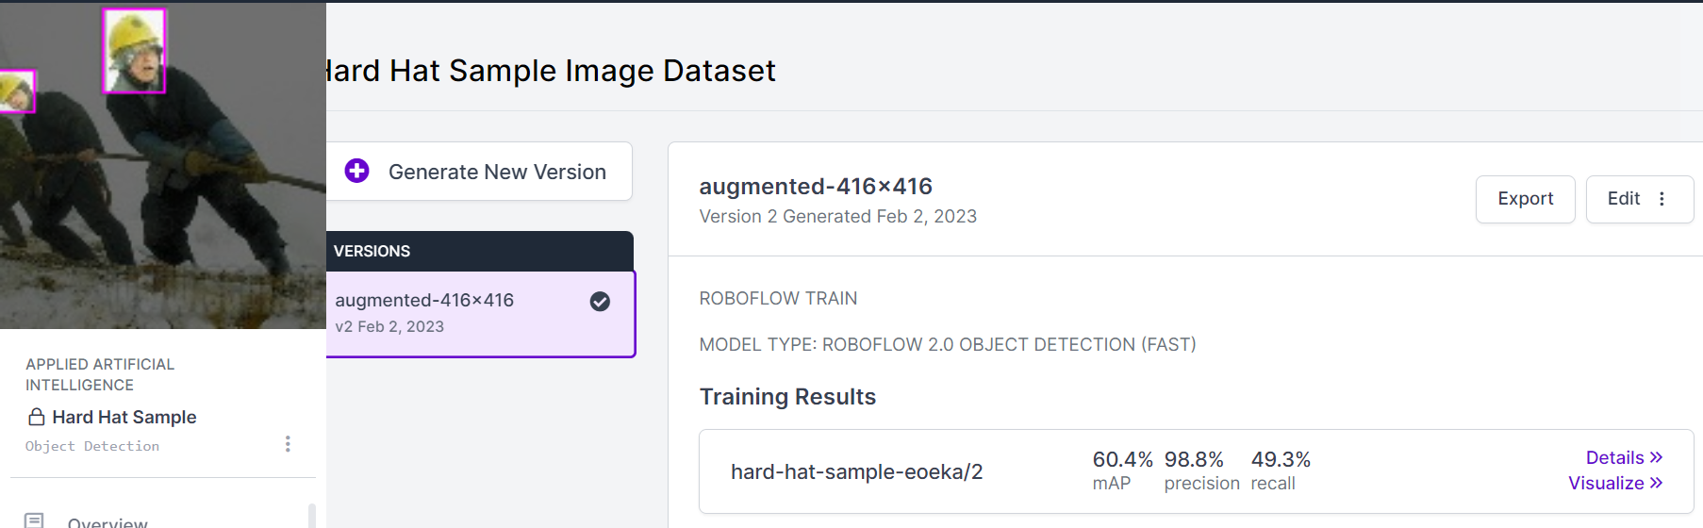
Solution Design
A series of stock photos would be selected to ensure that pre-trained model work in different environment.
Using image classification and segmentation in Roboflow, the model would detect if safety helmet is wore
If there is detection that safety helmet is not wore, a notification would be triggered to the respective department to confirm and investigate

Slide 9
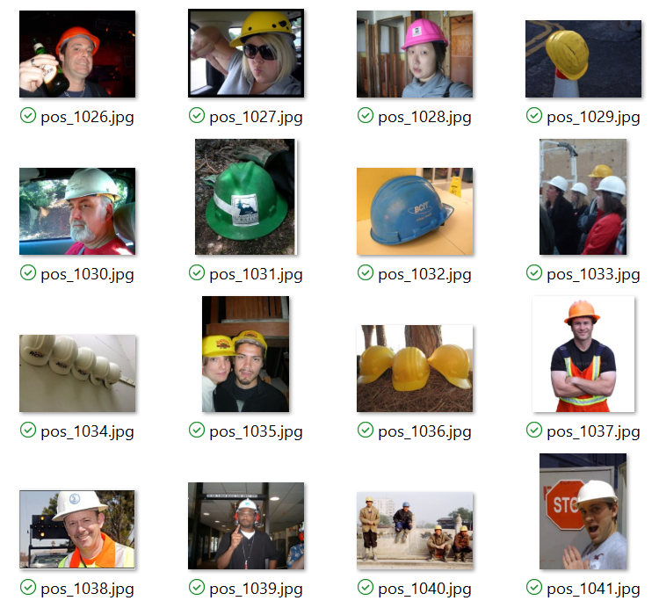
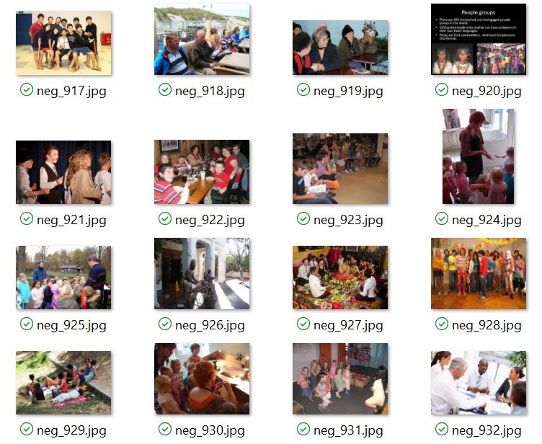
Model 1: Roboflow Data Collection
Data would be collected via photos of cassettes with / without safety helmet for training
With safety helmet
Without safety helmet

Slide 10
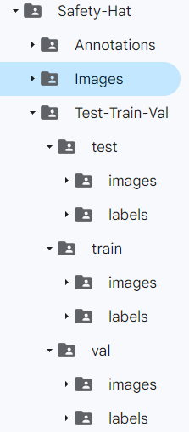
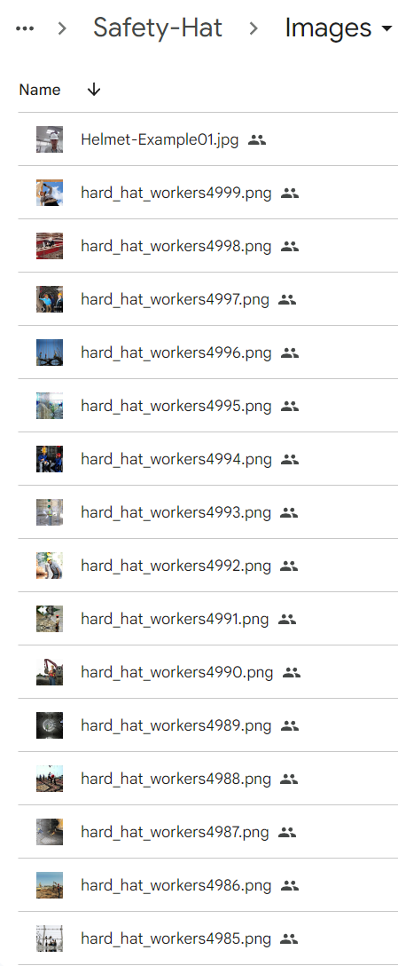
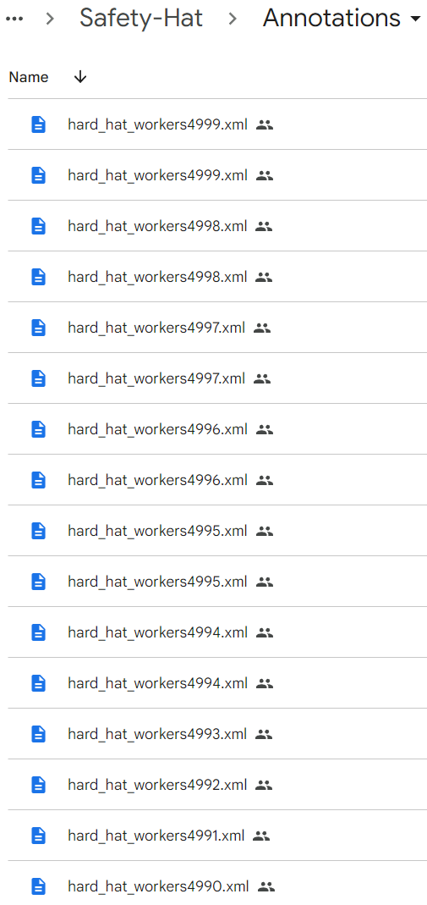
Model 1: Roboflow Validation/Train/Test
photos are divided into validation, train and test, which will be used for machine learning of this model.

Slide 11
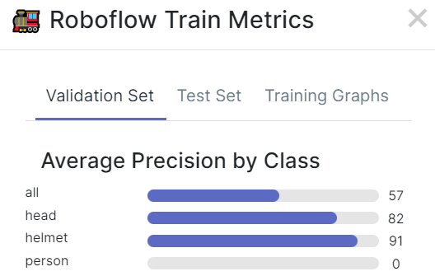
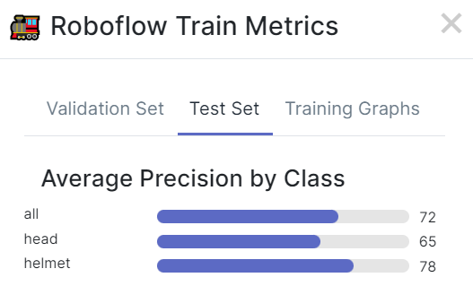
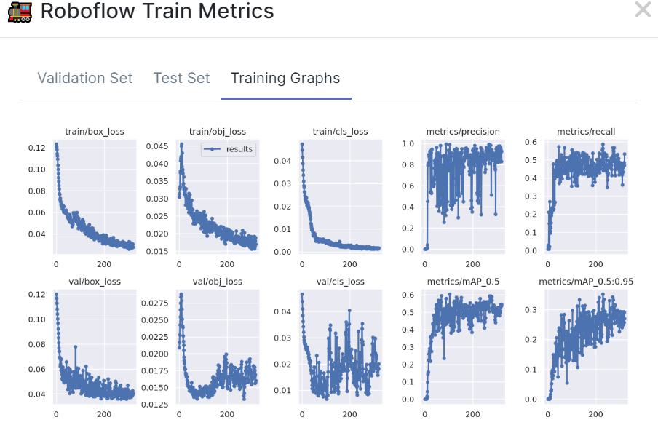
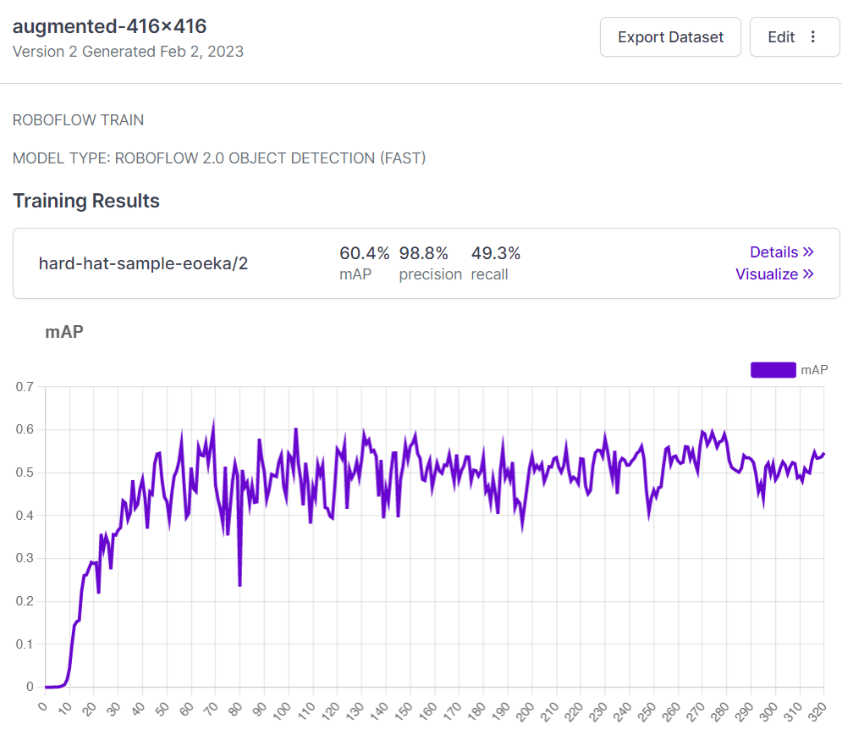
Model 1: Roboflow Evaluation
Training and test metrics are evaluated
Mean Average Precision (mAP): 60.4%

Slide 12
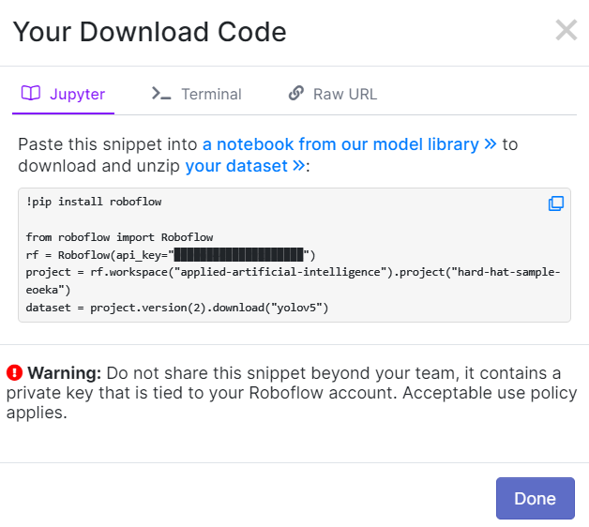
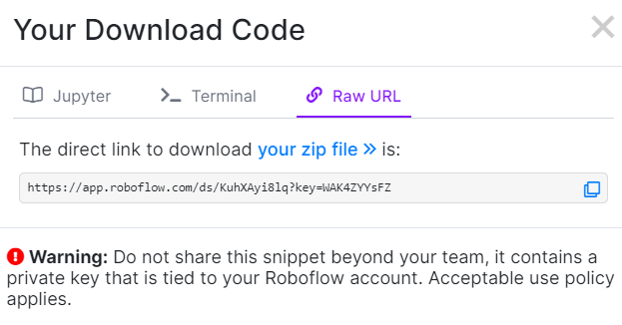
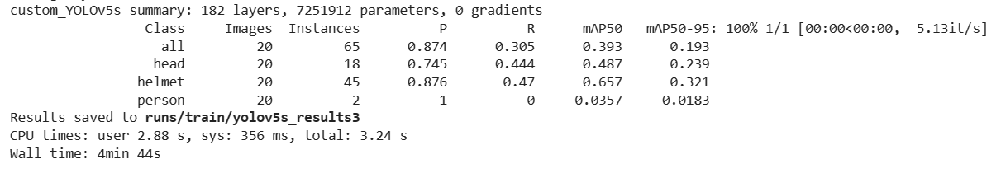
Model 1: Roboflow Evaluation
Using the roboflow trained dataset, the dataset is inferred in Jupyter notebook
When loaded to into the code to run, the mAP is still not satisfactory despite attempts to finetune the model with changes to the batch and epoch.

Slide 13
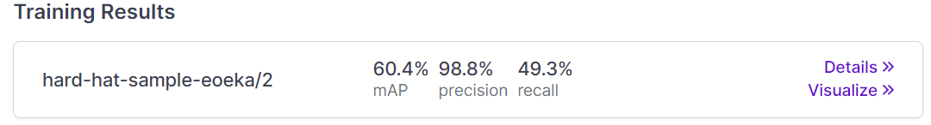
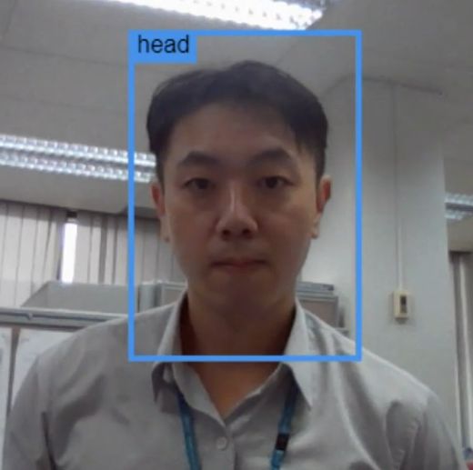
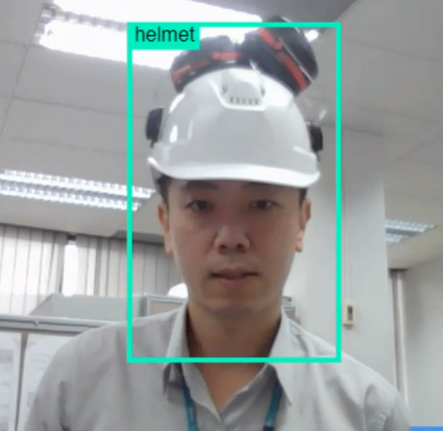
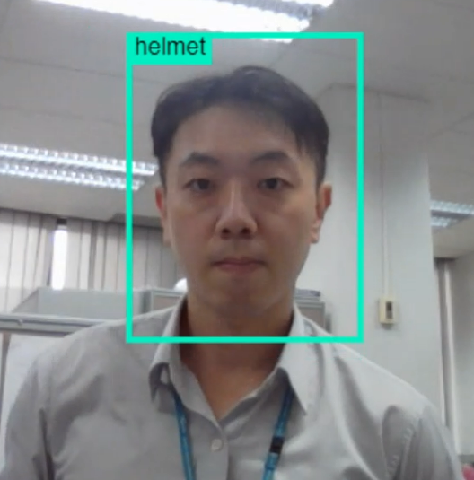
Model 1: Roboflow Result
Roboflow is used to train for safety helmet detection. However, the accuracy is still lacking in actual scenario
Correct Detection
Correct Detection
Incorrect Detection

Slide 14
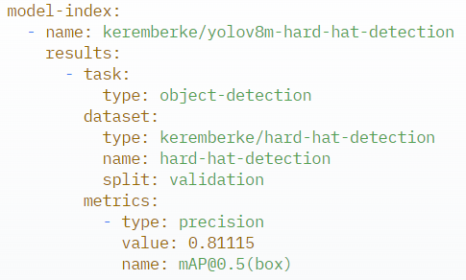
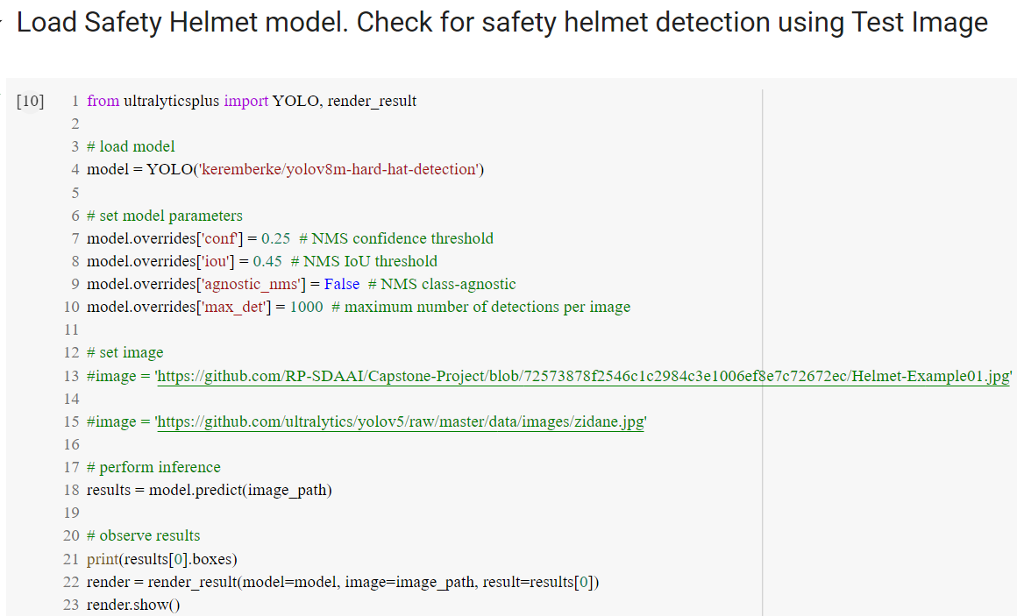
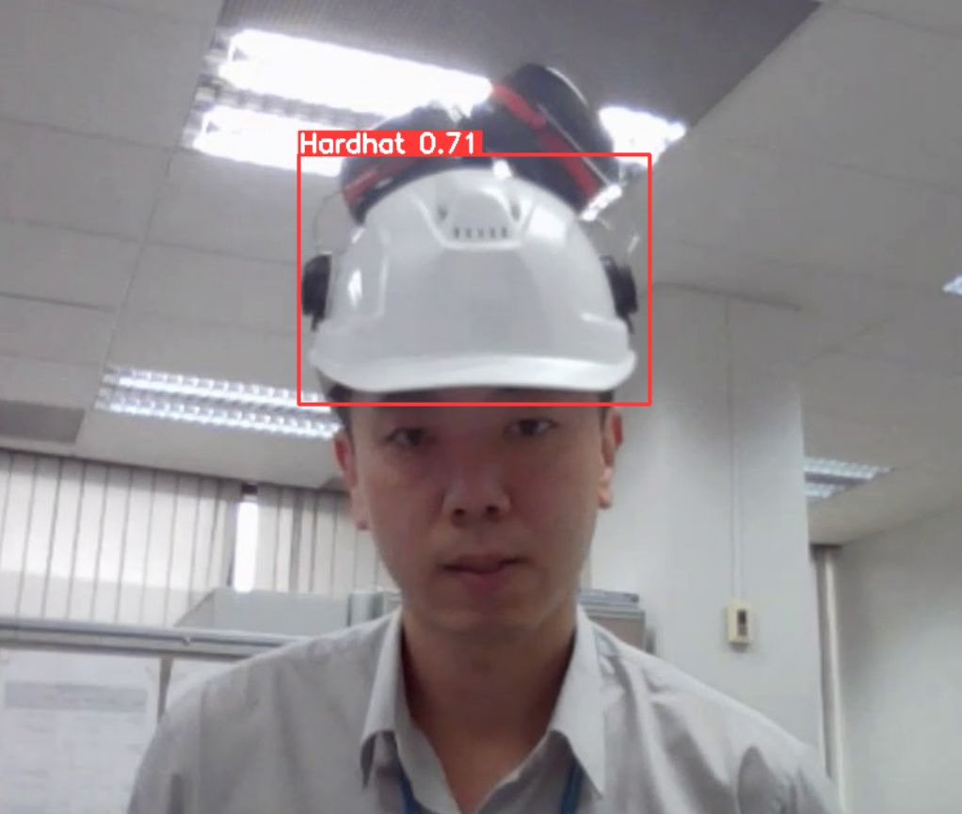
Model 2: Ultralytics Evaluation
Ultralytics offer a trained model with higher mAP@0.5
Model is loaded into Jupyter notebook. Result is satisfactory

Slide 15
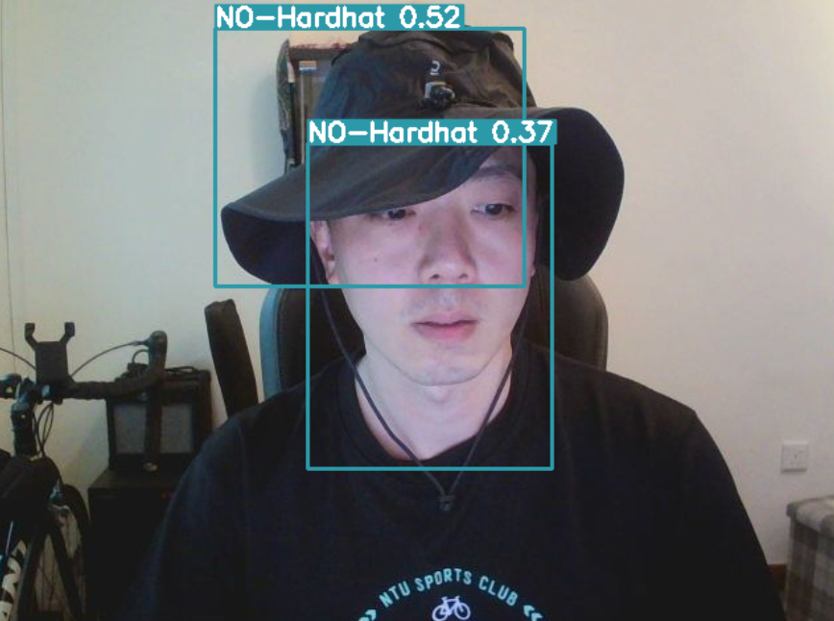
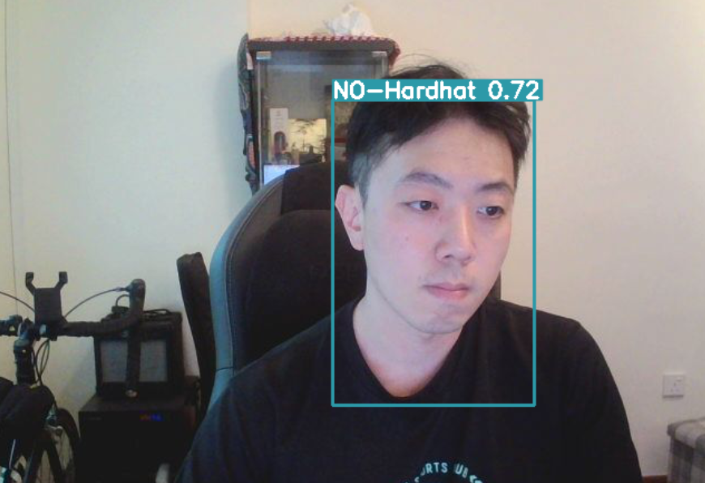
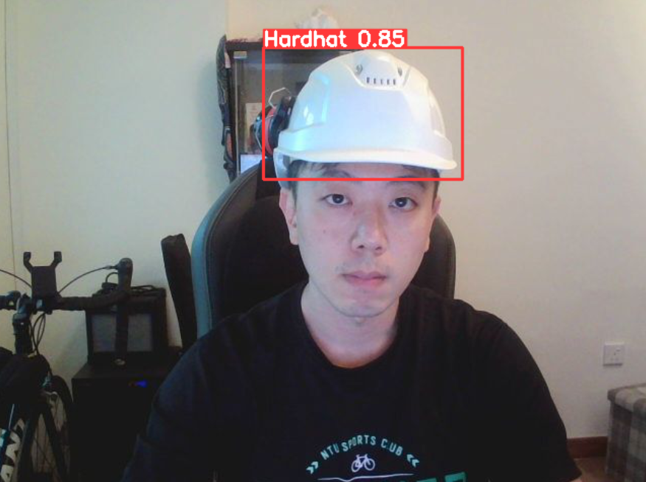
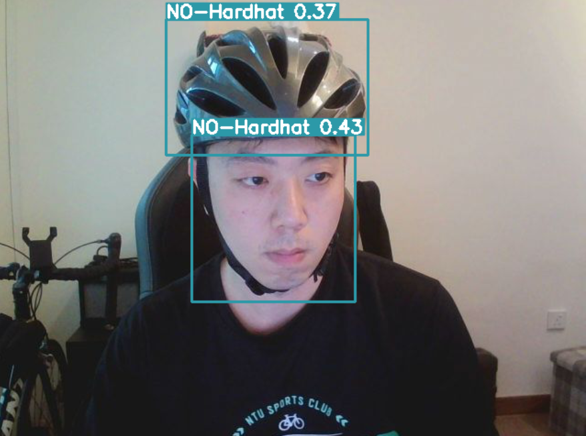
Model 2: Ultralytics Result
Model 2 showed better actual results

Slide 16
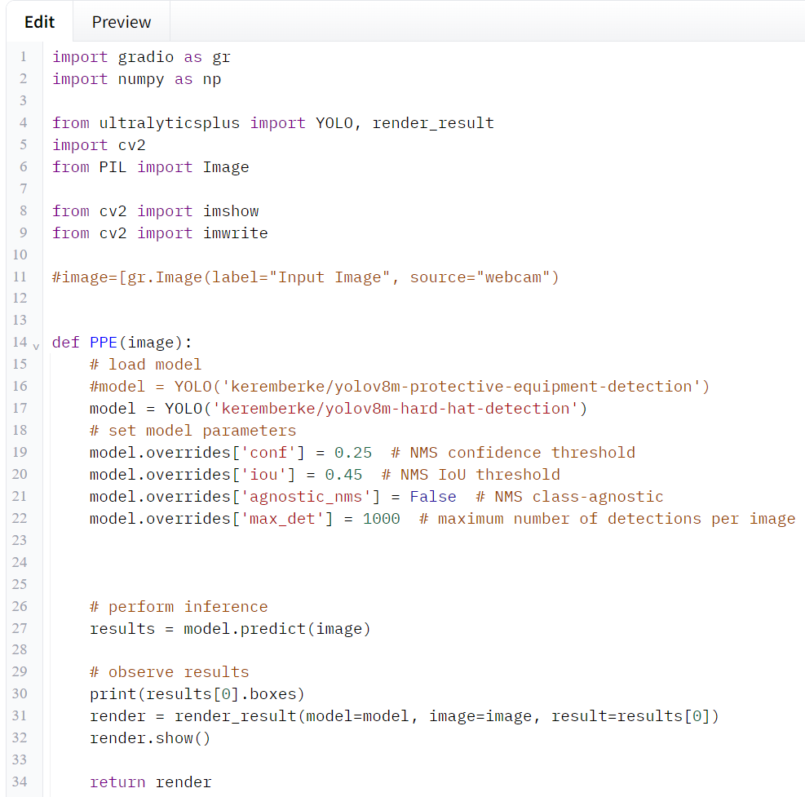
Machine Learning Deployment
Gradio is chosen as the platform for deployment. The app.py is edited to fit into Gradio platform

Slide 17
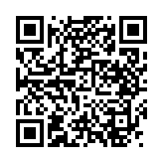
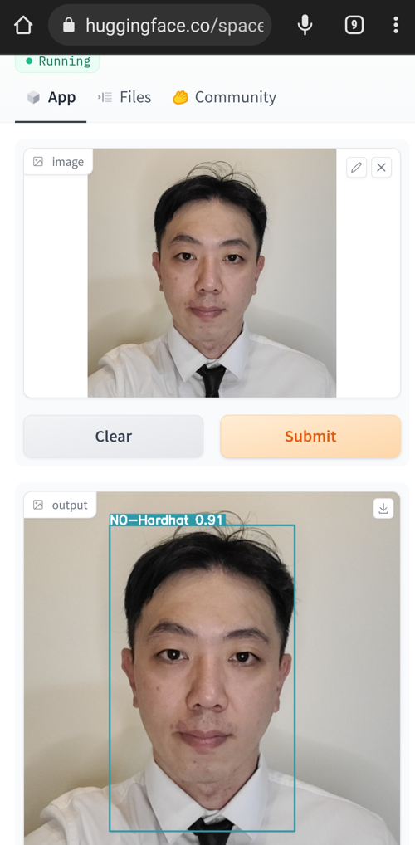
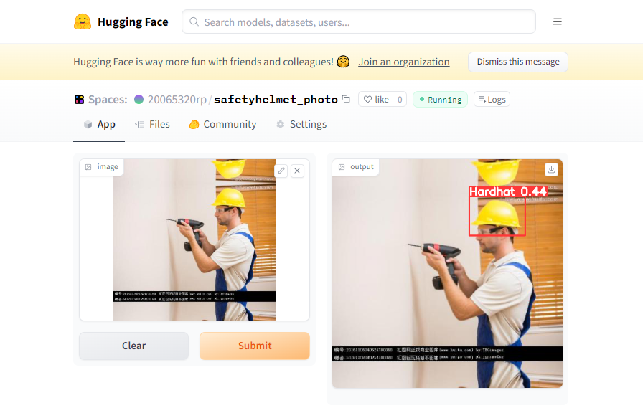

Machine Learning Deployment
Machine learning model is deployed into web interface via Gradio
First link
Second link
Scan to access Gradio Web interface for safety helmet detection
Mobile interface
Desktop interface
First link
https://huggingface.co/spaces/20065320rp/safetyhelmet_photo
Second link
https://huggingface.co/spaces/20065320rp/safetyhelmet_project

Slide 18
Conclusion
Based on the 2 models that are tested, it is determined that the second model is better at predicting the presence of safety helmet.
It is tested under different scenarios and the results showed that the model can provide more accurate predictions.
Gradio deployment is successful using Model 2

Slide 19
Challenge
Gradio present difficulty to deploy livestream video (cost involved)
Transfer learning of pre-trained model: Apply onto CCTV monitoring
How to detect non-conformance and trigger alert (e.g. email) to respective department

